Slide 1
ICT Communications Lesson 4: Creating Content for the Web

Slide 2
Objectives
2.4.1: Describe effective text and image content for Web pages based on how visitors use the Web.
2.4.2: List guidelines and conventions for effective text on a Web page.
2.4.3: Explain the inverted pyramid model of newspaper journalism and how it applies to Web content.
2.4.4: Use word-processing software to create effective written content for a Web page.
2.4.5: Create and/or edit message-driven image content for a Web page using graphics software.
2.4.6: Access graphics through various resources (e.g., scanner, digital camera, CD-ROM, clipart, copyright-free online graphics).
2.4.7: Plan the content and design of a basic Web page using strategies for effective Web communication, including brainstorming, determining audience, choosing content and media types, using white space.

Slide 3
Content Guudelines
Guidelines for Text on a Web Page
Element | Guidelines | Formatting
Paragraphs | Present only one idea per paragraph Limit paragraphs to 75 words or less Use chunking: Divide page text into small sections (chunks) using headings, subheadings, lists, short sentences and short paragraphs | Use bulleted lists to present related items or summarize key points Use numbered lists only when presenting a sequence of steps
Headings | Use headings and subheadings to divide and label text Make sure headings and subheadings focus on key points Headings should help readers find information quickly | Main headings should look larger than subheadings Headings and subheadings can use distinctive colors and fonts
Keywords | Words that best describe and summarize the purpose of your site Keywords help search engines find and rank your Web pages in users' search results Keywords help readers find information quickly on your pages | Can be used in page titles, headings, links, images and paragraph text Use bold formatting to make important words and phrases stand out in paragraphs Keywords should appear often in your pages

Slide 4
Inverted Pyramid
Places the most important information first.
It enables readers to get the basic facts by reading only the first sentence in a news story.
On a Web page, readers should get the basic facts just by scanning the page.
Readers who want more detail can read further on the page.
Readers who decide they want all the details can continue reading or follow a link to more information.

Slide 5
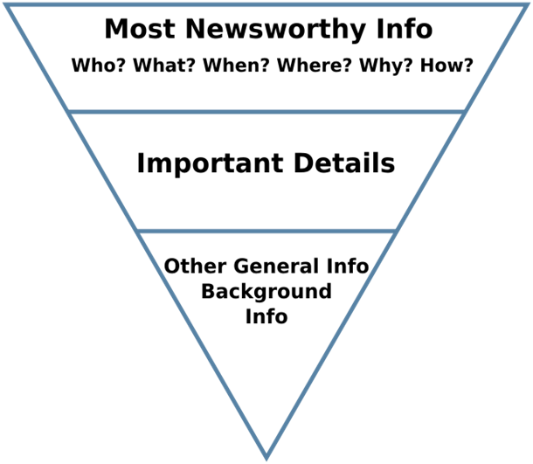
Inverted Pyramid

Slide 6
Images
A successful Web page uses words and images to capture the viewers' attention and provide information.
Graphics should be both visually appealing and informative.
Avoid graphics that distract users, increase downloading time, and obscure the message.
Graphics and text should complement each other.

Slide 7
Creating a Page
Brainstorming: a useful technique for creating and arranging online information
Everyone offers ideas and no idea is wrong
Narrow focus of ideas
Choose best idea or combination of ideas

Slide 8
Planning a Web Page (Site)
Who is the audience?
What will the audience want from the site?
Where will you get the site content?
Which media elements (text, images, video) are more effective for certain types of sites?
What characteristics might make one image more effective than another?
Think about how you will remove unneeded content, align your text, and group related items.
White space keeps a Web page from looking too busy. White space also makes a Web page easier to read and scan for information.

